Slide 1
5: Church
3: Park
4: Street
2: Sewers
1: Street

Slide 2
Zone 1: Street
1
End
Introduction zone.
Teaches the basics of how to control character, shouldn’t be too difficult.
No enemies.
A
Basic Puzzle
Start
1

Slide 3
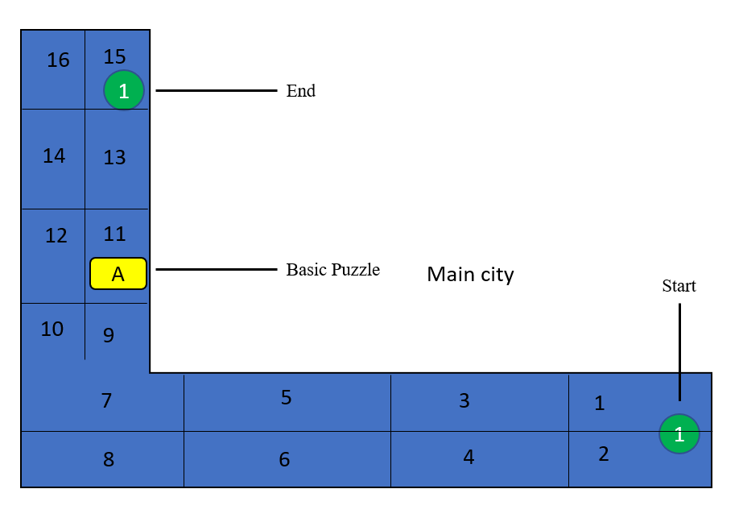
Zone 1

Slide 4
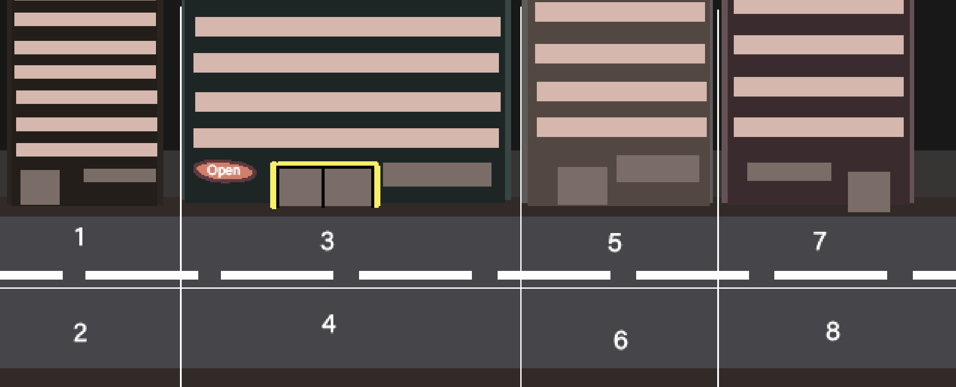
1 - 9

Slide 5
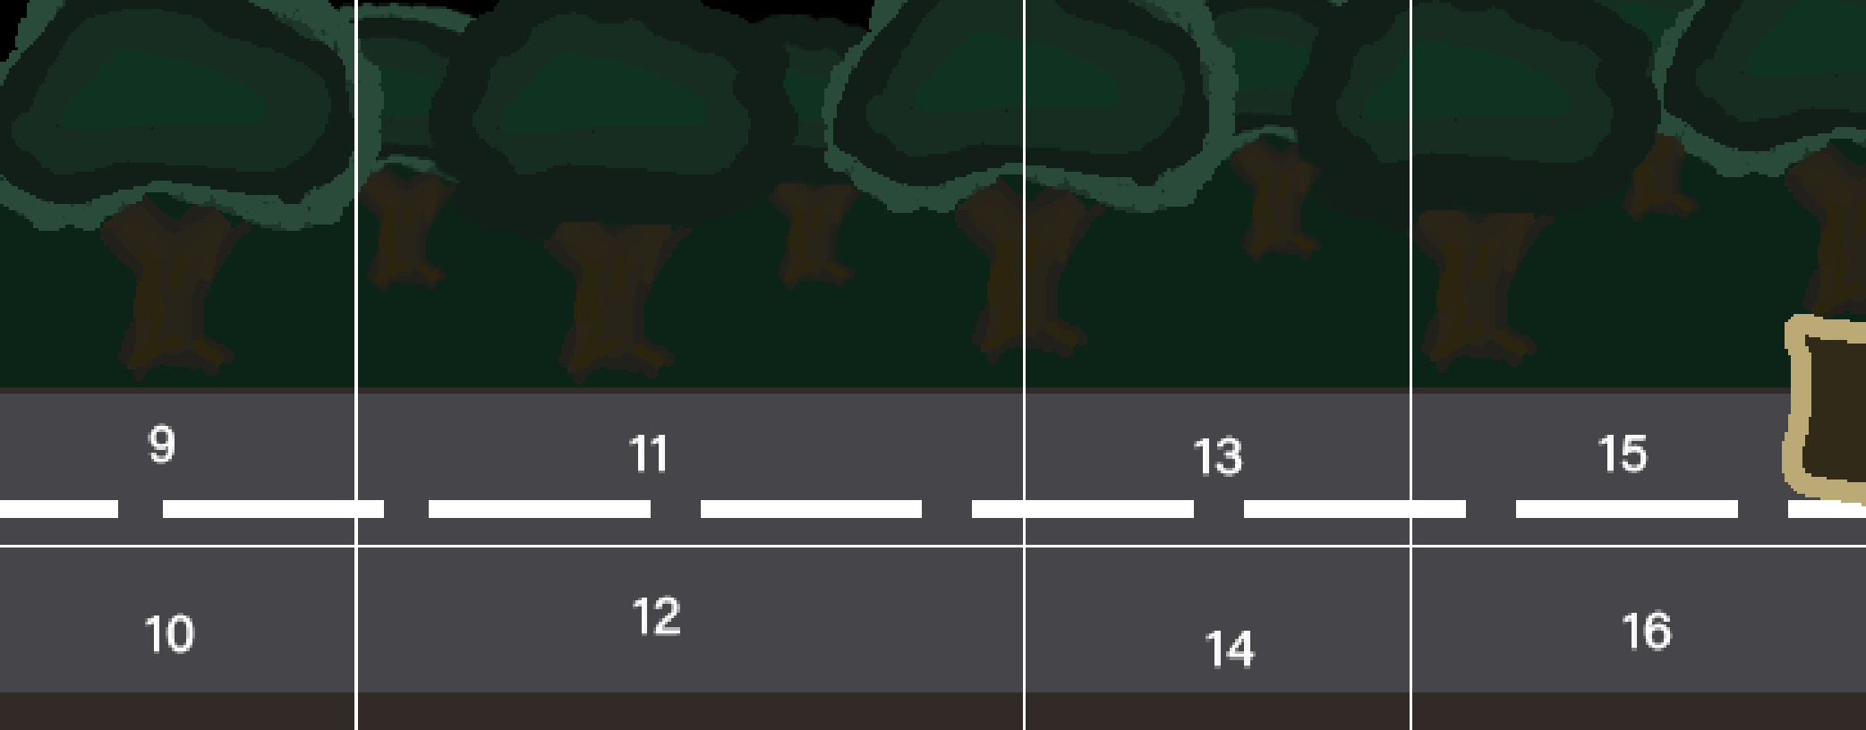
9 - 16

Slide 6
Zone 2: Sewers
2
Health
H
C
Map 4
Map 5
S
Start
Sewers Enemy
Map 3
C
Puzzle
B
2
Map 1
S
Required to Solve Puzzle
B
Map 2
S

Slide 7
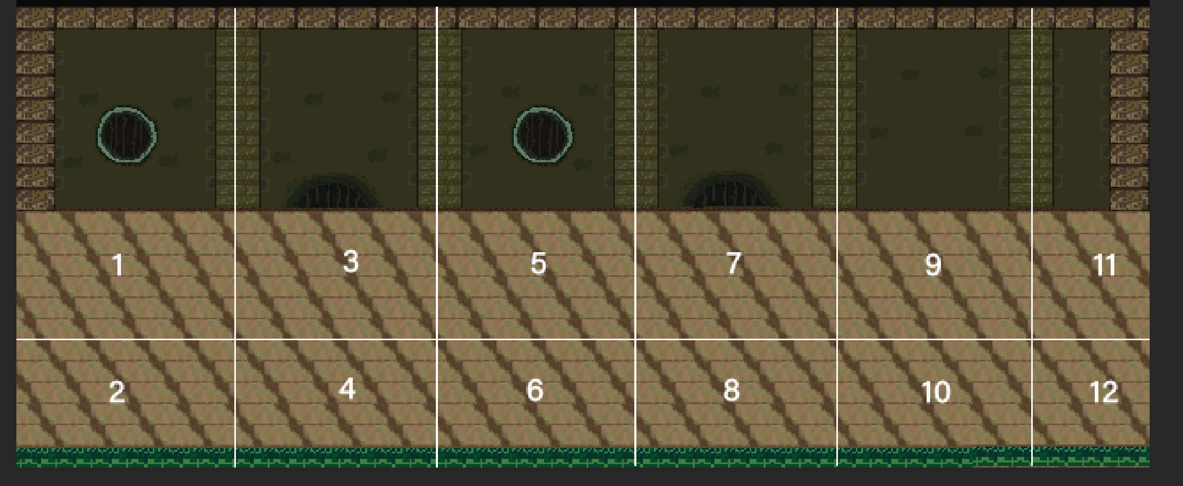
How the map 1 will look like

Slide 8

Map 1
Map 1
1
3
5
7
9
11
2
4
6
8
10
12

Slide 9
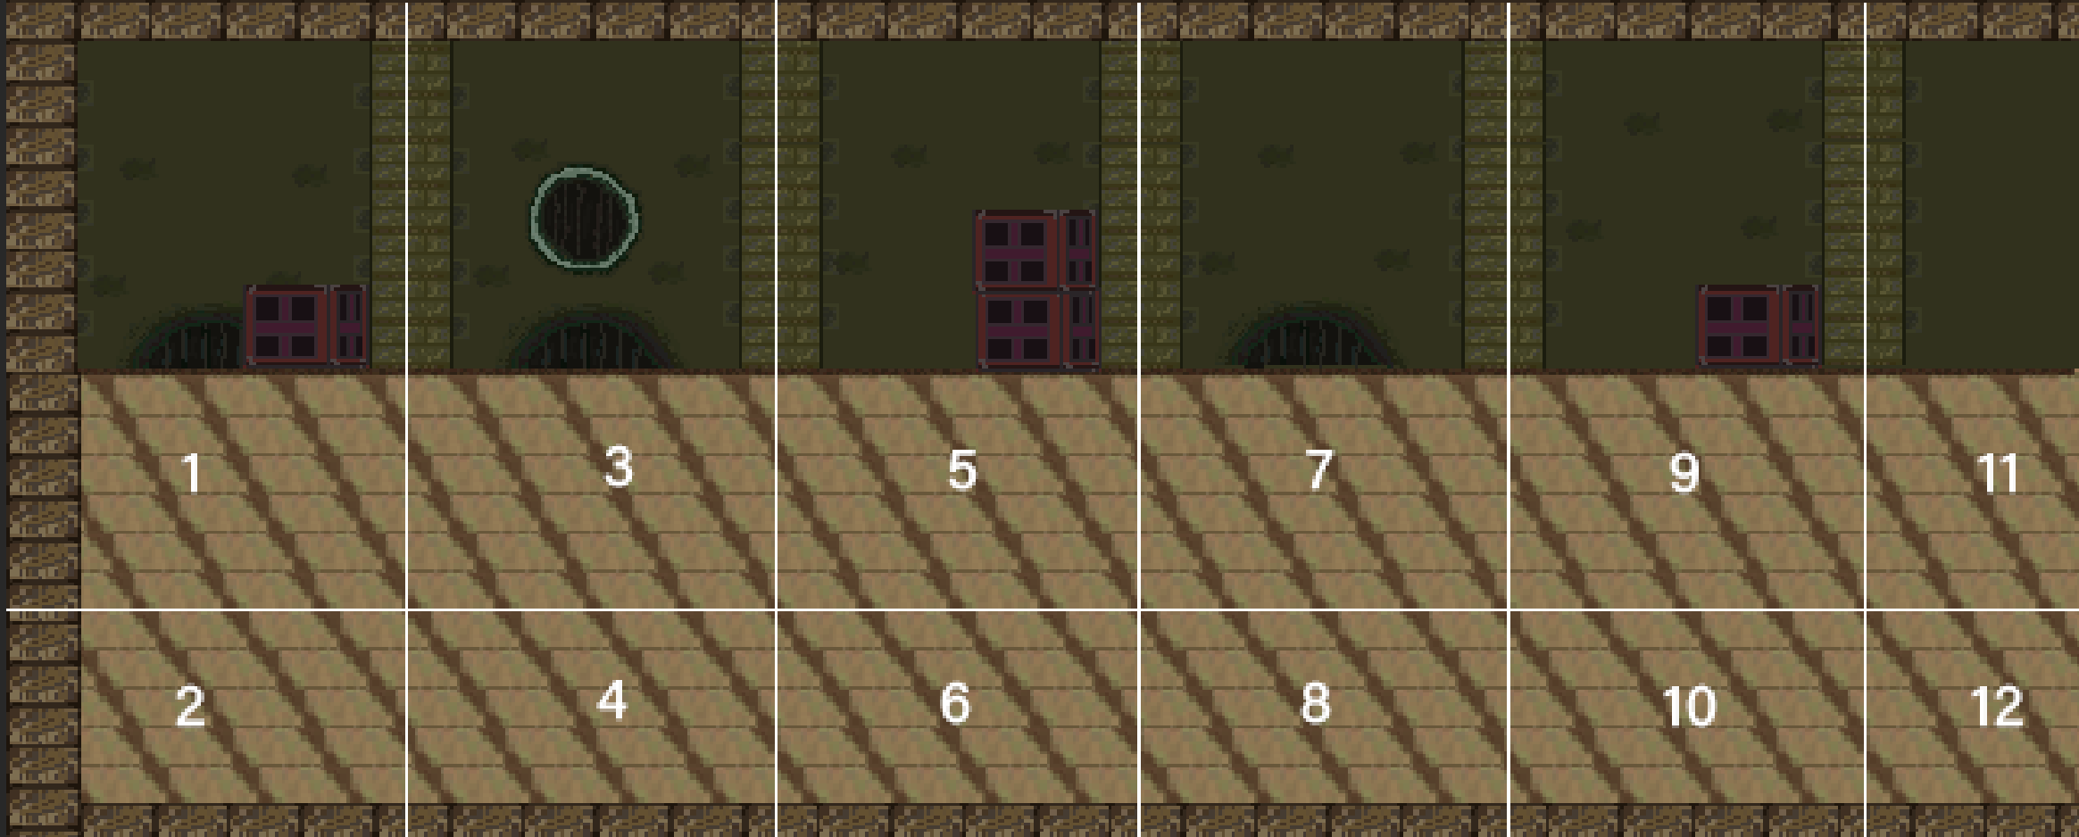
How the map 2 will look like

Slide 10
Map 2
Map 2
1
3
5
7
9
11
2
4
6
8
10
12

Slide 11
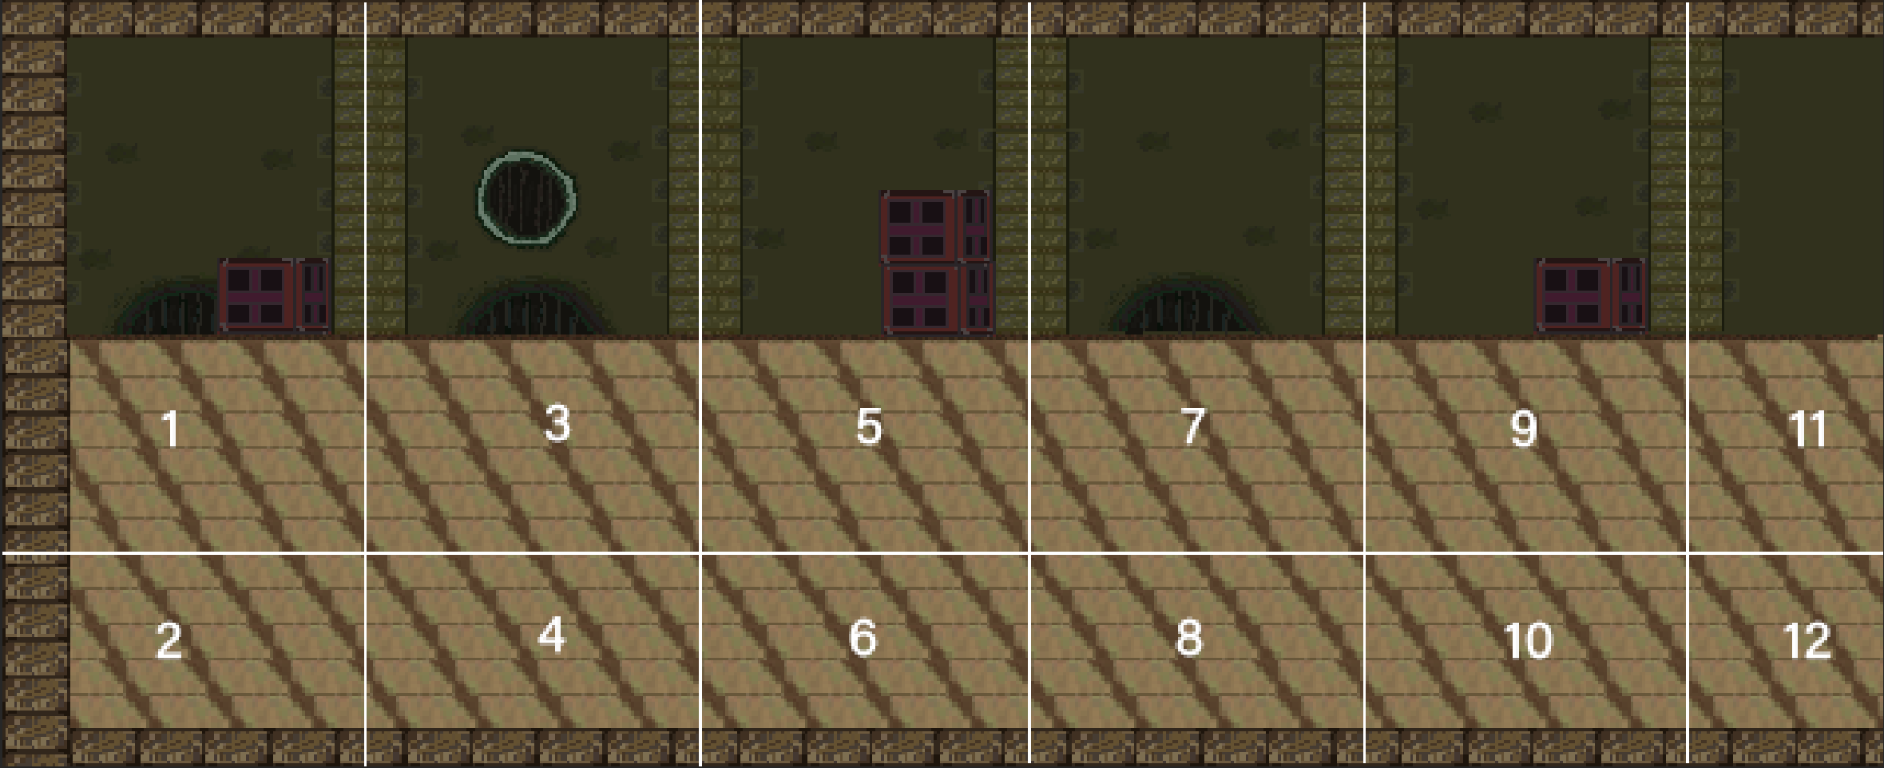
How the map 2 will look like

Slide 12
Map 3
13
14
11
12
9
10
7
8
5
6
3
4
1
2

Slide 13
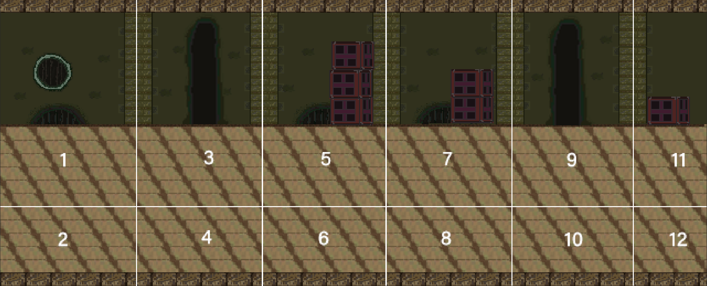
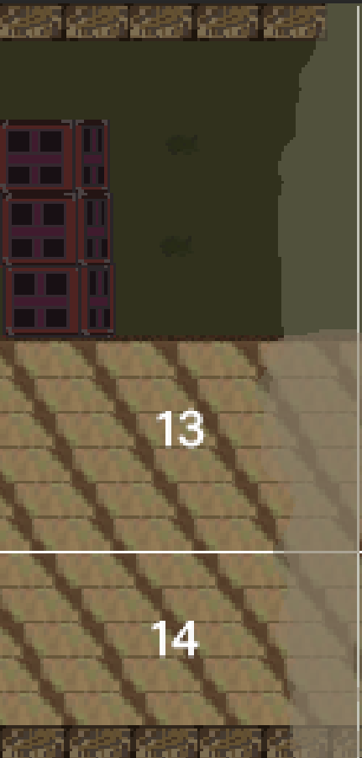
How the map 3 will look like

Slide 14

Map 4
1
3
2
4

Slide 15
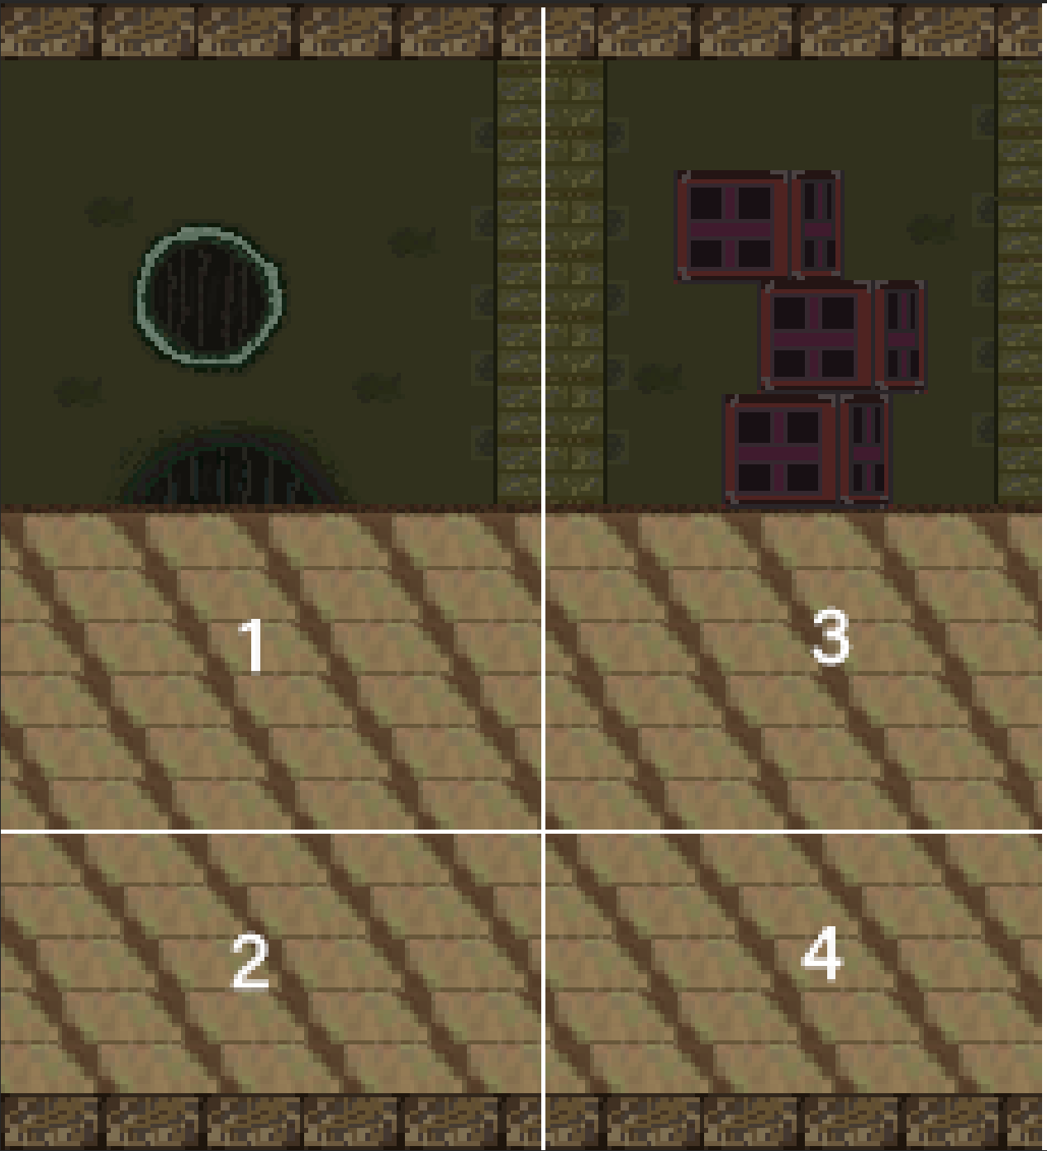
How the map 4 will look like

Slide 16
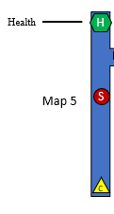
Map 5
2
1
4
3
6
5
8
7

Slide 17
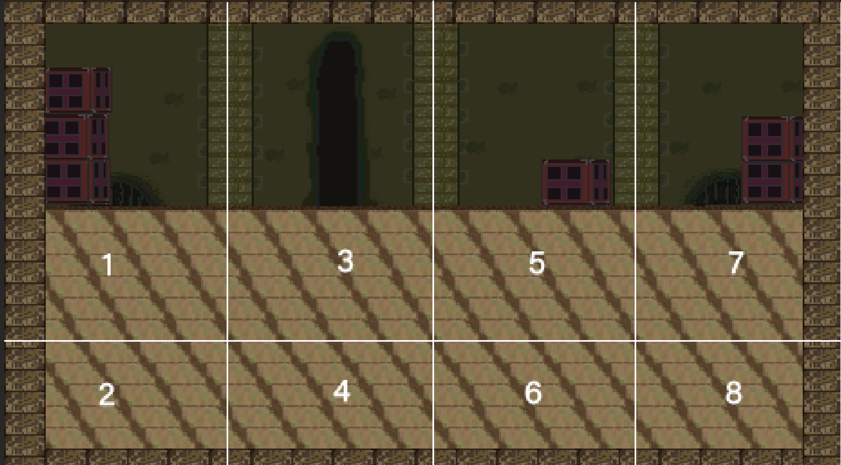
How the map 5 will look like

Slide 18
Zone 3: Park
Tree
H
D
D
E
D
More advanced puzzles.
More difficult enemies.
Open area.
Could contain scenery.
E
Enemy
Statue Puzzle
From
Sewers
3
3

Slide 19
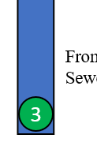
Map 1
1
2

Slide 20
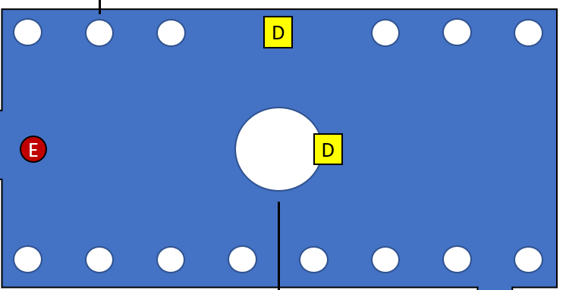
Map 2
1
4
7
10
13
16
2
11
5
14
17
8
3
6
9
12
15
18

Slide 21

Map 3
1
2

Slide 22
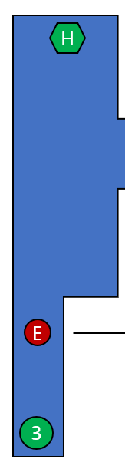
Map 4
1
2
3
4
5
6
7
8

Slide 23
Zone 5: Church
H
F
S
S
Staircase
F
Enemy
E
E
B
Boss Enemy: End
Start
5

